Slide 1

COMPUTER SCIENCE AND ENGINEERING
PROJECT REVIEW
TITLE: BLOOD GROUPING DETECTION USING IMAGE PROCESSING AND DEEP LEARNING
Supervisor:
DR. Y. MOHANAROOPA
Presented By:
G. JASHWANTH SAI (20951A0561)
T. MARY RISHITHA (20951A0586)
P. JAYA SURYA (20951A0563)
Project Batch No:09

Slide 2
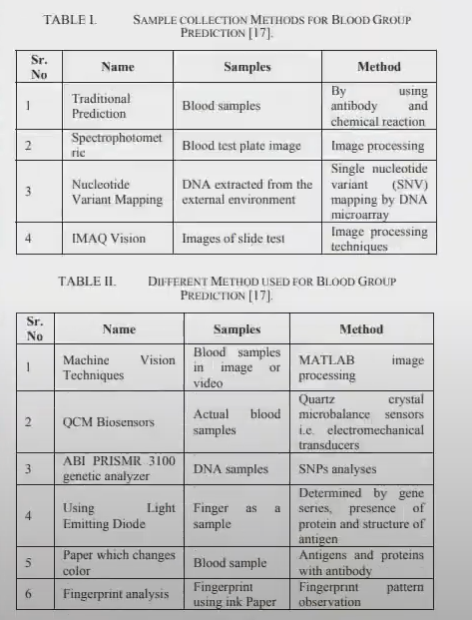
METHODOLOGIES:
The composing shows association between blood get-together and one of a kind imprint plan summary as follows: Loops were the chosen essential finger impression structure and Arches were the most un-typical. Whorls and mixed were reasonable, most outrageous records of circles stayed found in O and B related to An and AB. The O +ve is the furthermost normally found in models, while O - ve and AB- vers the most extraordinary. Blood bundle A was the most joint blood pack among folks, however O and B, are the most generally noticed blood bundles in females.

Slide 3
OBJECTIVE :
In this project, Proposing approaches for blood Group measurement with the aim of recommending data collection techniques, signal extraction processes, Feature calculation processes, Image Processing algorithms for developing a noninvasive Blood Group estimation using a Image.

Slide 4
ABSTRACT :
There is worldwide demand for an affordable Blood Group measurement solution, which is a particularly urgent need in developing countries.
The Image Processing, which is the most penetrated device in both rich and resource-constrained areas, would be a suitable choice to build this solution.
This Project proposes a noninvasive Blood Group measurement processes. Also its compared the variation in data collection sites, Bio-signal processing techniques, theoretical foundations, PhotoPlethysmogram (PPG) signal and features extraction process, Image Processing algorithms, and Detection models to calculate Blood Groups.
This analysis was then used to recommend realistic approaches to build a Image-Processing-based point-of-care tool for Blood Group measurement in a noninvasive manner.

Slide 5
INTRODUCTION :
Blood Group abnormalities cause several blood diseases, and lead to fatal and chronic health problems, including heart attack, stroke, and pregnancy complications.
When an adequate blood is not maintained, the disorder complicates the function of the major organs (Example: Kidney, Brain, and Heart) that require oxygen.
Thus, an disorder diagnosis based on an invasive method is not a perfect solution, especially for people with abnormalities and in low- and middle-income countries.

Slide 6
EXISTING SYSTEM:
Blood Group level measurement is a blood diagnosis process to determine the concentration of cell count in the blood. Clinicians measure Blood Group in several ways.
Although the invasive (blood sample collection) approach remains the most common.
Invasive processes involve the addition of various chemicals to a blood sample and then optical variations are calculated using spectroscopic data to measure the Blood Group level.

Slide 7
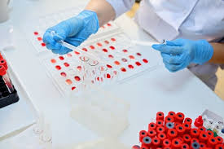
EXISTING SYSTEM:
Invasive Blood Detecting Method.

Slide 8
DRAWBACKS:
Challenging data collection methods.
Complex data analysis and feature extraction processes.
Lack of affordability and portability.
It is a Time consuming process.
Lack of user-friendliness with costly external modules.

Slide 9
PROPOSED SYSTEM:
A noninvasive (without blood sample collection) approach involves data obtained from image sensors, spectroscopic information, and output of a Photoplethysmographic (PPG) sensor to calculate the Blood Group level.
A Image Processing-based POC tool as a potential alternative to invasive clinical blood testing is rapidly attracting attention because of the advantages of availability, user-friendliness, and easy attachability to different biosensing devices.

Slide 10
PROPOSED SYSTEM:
The fingertip area is one of the best data collection sites from the body, followed by the lower eye conjunctival area.
Near-infrared (NIR) light-emitting diode (LED) light were identified as potential light sources to receive a Blood Group response from living tissue.
PPG (Photoplethysmogram) signals from fingertip videos, captured under various light sources, can provide critical physiological clues.
The features of PPG signals captured under NIR LED are considered to be the best signal combinations following a dual-wavelength theoretical foundation.

Slide 11
PROPOSED SYSTEM:
The PPG signal is generated from each video, and multiple characteristic features are then extracted from the PPG signal, its derivatives and from Frequency analysis.
Genetic algorithms (GA) has been used to select the optimal features (Feature selection).
Finally, CNN based models have been developed to estimate the Blood Group (Blood Group) levels from the selected features.
The approach expected to provides the best-estimated accuracy of around 98%.

Slide 12
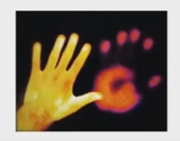
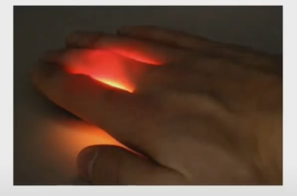
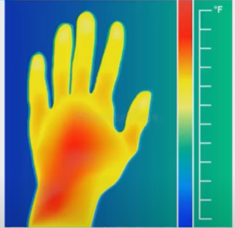
PROPOSED SYSTEM:
O (+ve) Spectroscopic Image.
Noninvasive Detecting Method.
A (+ve) Spectroscopic Image.

Slide 13
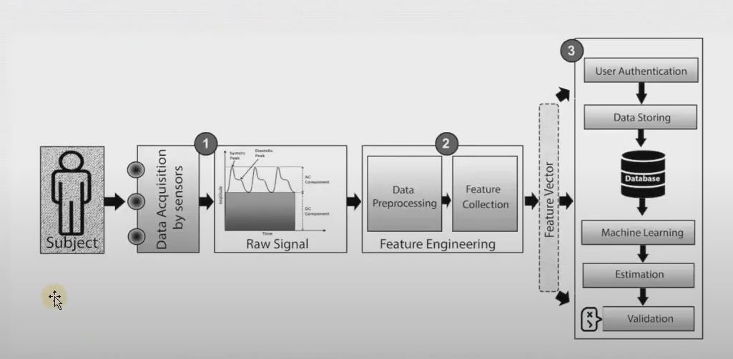
PROPOSED BLOCK DIAGRAM:
Block Diagram for Proposed Model.

Slide 14
REFERENCES :
[1] Ataga KI, Gordeuk VR, Agodoa I, Colby JA, Gittings K, Allen IE. Low Blood Group increases risk for cerebrovascular disease, kidney disease, pulmonary vasculopathy, and mortality in sickle cell disease: A systematic literature review and meta-analysis. PLoS One 2020 Apr 3;15
(4):e0229959 [FREE Full text] [doi: 10.1371/journal.pone.0229959] [Meline: 32243480].
[2] van Swelm RPL, Wetzels ] FM, Swinkels DW. The multifaceted role of iron in renal health and disease. Nat Rev Nephrol2020 Feb 25;
16(2):77-98. [doi: 10.1038/s41581-019-0197-5] [Medline: 31554933].
[3] Mann D, Riddell L, Lim K, Byrne LK, Nowson C, Rigo M, et al. Mobile phone app aimed at improving iron intake and bioavailability in premenopausal women: a qualitative evaluation. IMIR Mhealth Uhealth 2015 Sep 28;
3(3):e92 [FREE Full text] [doi: 10.2196/mhealth.4300] [Medline: 26416479].

Slide 15
REFERENCES :
[4] Mann D, Riddell L, Lim K, Byrne LK, Nowson C, Rigo M, et al. Mobile phone app aimed at improving iron intake and bioavailability in premenopausal women: a qualitative evaluation. IMIR Mhealth Uhealth 2015 Sep 28;
3(3):e92 [FREE Full text] [DOI: 10.2196/mhealth.4300] [Medline: 26416479].
[5] Le CHH. The prevalence of anemia and moderate-severe anemia in the US population (NHANES 2003-2012). PLoS One2016 Nov 15;
11(11) : 0166635 [FREE Full text] DOI: 10.1371/journal. pone.0166635] [Medline: 27846276].
[6] Krishnamurti L, Ross D, Sinha C, Leong T, Bakshi N, Mittal N, et al. Comparative effectiveness of a web-based patient decision aid for therapeutic options for sickle cell disease: randomized controlled trial. J Med Internet Res 2019 Dec04;
21(12):14462 [FREE Full text] [doi: 10.2196/14462] [Medline: 31799940].

Slide 16



